Slide 1
Computer-Generated Pen-and-Ink Illustration
An OpenGL Project
Adarsh
2021442

Slide 2
Introduction
Briefly explain the significance of 3D rendering in computer graphics.
Introduce the project goal:The primary objective of this project is to implement a rendering system that achive realistic pen Ink illustration ,
utilizing a 3D Binary Space Partition (BSP) tree and PlanarMap for gener-
ating computer-generated pen-and-ink illustrations. While successful in im-
plementing BSP trees for simple geometric shapes like a cube and a square,
challenges persist in rendering more intricate shapes such as the bunny and
Buddha. Additionally, the project has made significant progress in creating
textures on the PlanarMap. Achieving fully realistic rendering remains an
ongoing effort. The rendering pipeline, driven by robust OpenGL rendering
techniques, stands out as a notable achievement

Slide 3
Project Overview
2.1 Setting Up Basic Rendering
Accomplishments:
• Configured a windowing system and initialized OpenGL for basic ren-
dering.
• Successfully established the rendering pipeline to display simple geo-
metric shapes like a cube and a square.
2.2 Implementing 3D BSP Tree
Accomplishments:
1

Slide 4
.
• Successfully implemented a 3D BSP tree for efficient sorting and culling
of polygons.
• Achieved successful rendering of simple geometric shapes, such as a
cube and a square.
• Applied texture through mapping the texture successfully .
• Introduced partitioning in the BSP tree to enhance handling of complex
shapes.
• Ongoing efforts in optimizing partitioning for complex shapes.
2.3 Creating PlanarMap
Accomplishments:
• Implemented a PlanarMap to encode polygon adjacencies, establishing
a 3D partition in normalized device coordinates (NDC).
• Successfully integrated textures into the PlanarMap.

Slide 5
Key Features
Showcase bullet points of project features:
- 3D rendering of a cube with BSP Trees.
- Loading and rendering OBJ models.
- Texture mapping and multitexturing.
- Planar Mapping for outline strokes.
- User interaction for camera control.
- Stroke color and texture improvements in PlanarMap.

Slide 6
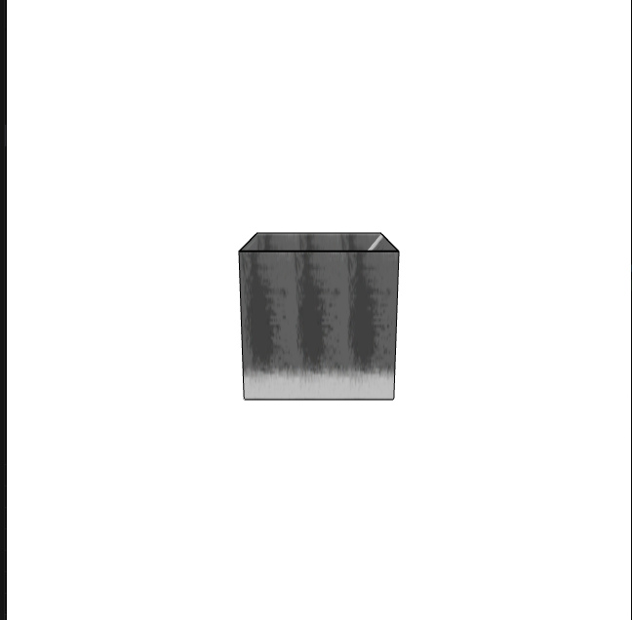
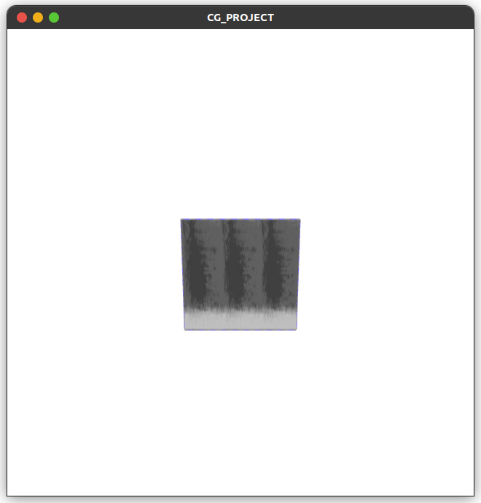
Demo Screenshots
.

Slide 7
Code Snippet - Cube Rendering
```cpp
// Code snippet for cube rendering with BSP Trees
BSPtree cubeBSP(cubeVertices, cubeTextureCoords);
cubeBSP.render(modelTransform, textureID);
```

Slide 8
Code Snippet - OBJ Model Loading
```cpp
// Code snippet for loading and rendering OBJ model
const char* objFilename = "src/bunny.obj";
OBJModel bunnyModel = loadOBJ(objFilename);
BSPtree bunnyBSP(bunnyModel.vertices, bunnyModel.textureCoords);
bunnyBSP.render(modelTransform, textureID);
```

Slide 9
Code Snippet - Texture Mapping
```cpp
// Code snippet for texture mapping
unsigned int texture;
// ... Texture loading code
// In rendering loop
glBindTexture(GL_TEXTURE_2D, texture);
// ... Rendering code
```

Slide 10
Code Snippet - Planar Mapping
```cpp
// Code snippet for Planar Mapping with improved strokes
PlanarMap planarMap;
planarMap.addFace(cubeVertices);
planarMap.generateOutlineStrokes(shaderProgram, textureID);
```

Slide 11
Code Snippet - User Interaction
```cpp
// Code snippet for user interaction (camera control)
while (!glfwWindowShouldClose(window)) {
glfwPollEvents();
// ... Handle user input
// ... Update view matrix
// ... Rendering code
}
```

Slide 12
Challenges Faced
Ongoing efforts to manage stroke colors and textures for enhanced realism.
Addressing challenges in coordinating strokes with complex models.
• Encountered difficulties in rendering more complex shapes on Bsp like the bunny.obj and Buddha.obj.
• Addressed challenges in achieving realistic rendering for intricate mod-
els.

Slide 13
Conclusion
While successful in implementing the BSP tree for simple geometric shapes
and creating textures on the PlanarMap, challenges persist in rendering more complex shapes and achieving fully realistic rendering. The addition of partitioning in the BSP tree addresses some challenges, providing a foundation for further enhancements. The project, powered by a robust rendering pipeline,
continues to evolve, opening avenues for further exploration in computer-
generated illustration techniques within the realm of computer graphics.
The ongoing efforts in this project aim to overcome challenges and elevate
the capabilities of computer-generated pen-and-ink illustration techniques.

Slide 14
Thank you
.

